Slide 1
Event Marketing on a Shoestring
Presented by Shainy Edelman | Click Consulting

Slide 2
OVERVIEW
Part 1: Strategy – the 3R rule
Part 2: Systems: The 3 basic platforms to market your events
  Your website
  Your email list
  Your facebook page
Part 3: Execution

Slide 3
STRATEGY
Your event attendees are busy, and they’re drowning in a sea of marketing messages. How will you stand out?

Slide 4
Strategy
What’s involved in an effective campaign?
CHALLENGE:
Every day, your potential attendees hear and see thousands of
Facebook ads
Emails
Google banners
Sponsored Tweets
You need to cut through the noise. You need to be different.
GOAL:
3-R Rule:
Read
Retain
Respond
Practical Pointers on getting results >

Slide 5
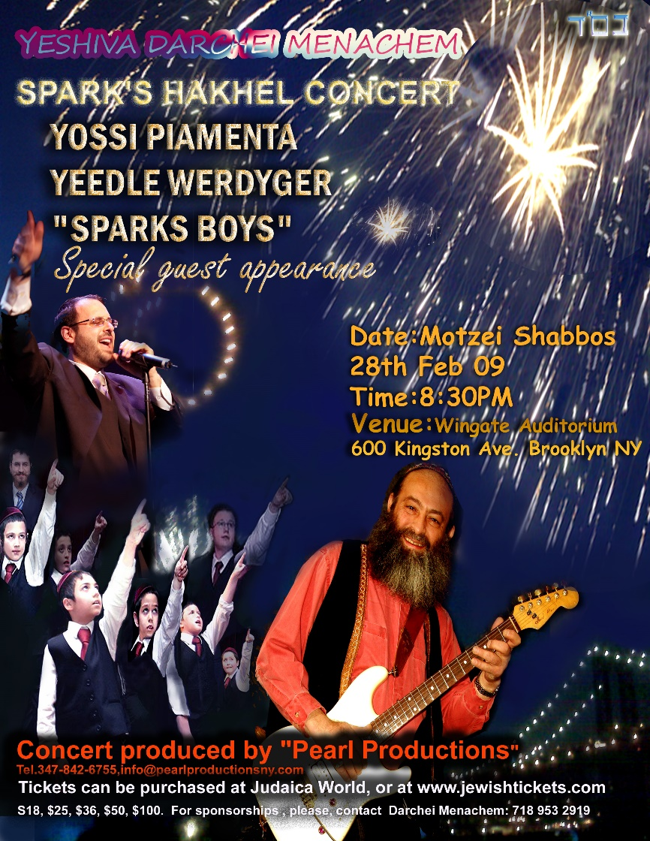

Strategy
Pointer #1: READ - You only have 8.25 seconds to make a first impression.
The average human attention span is 8.25
seconds.

Slide 6
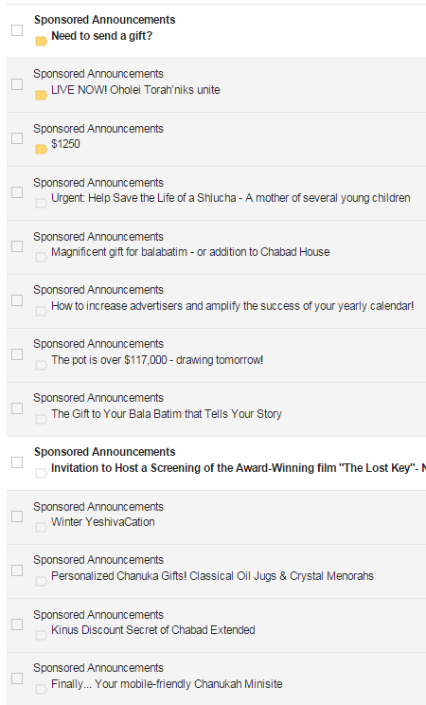
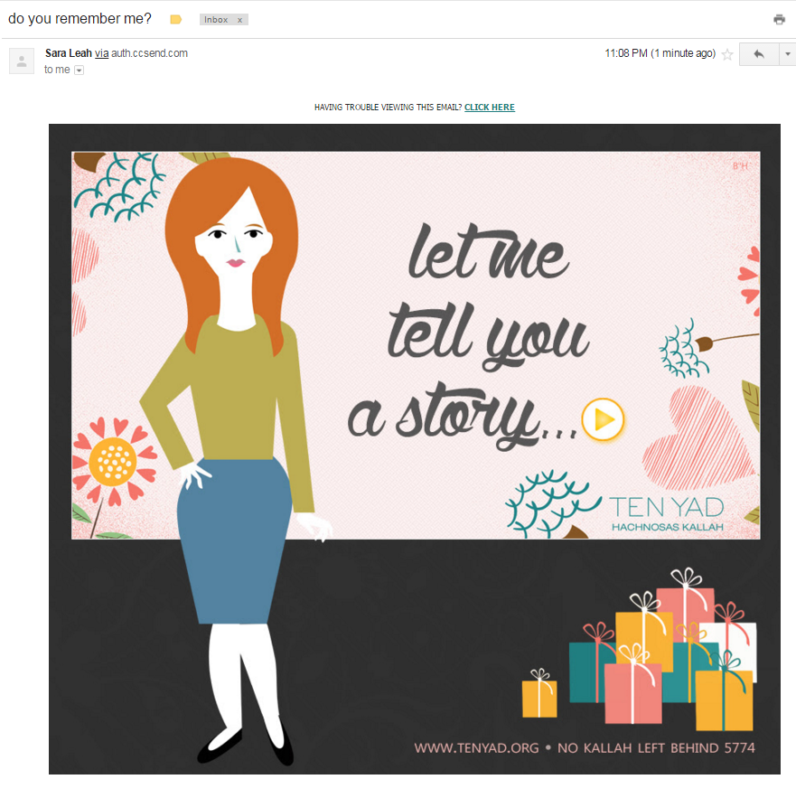
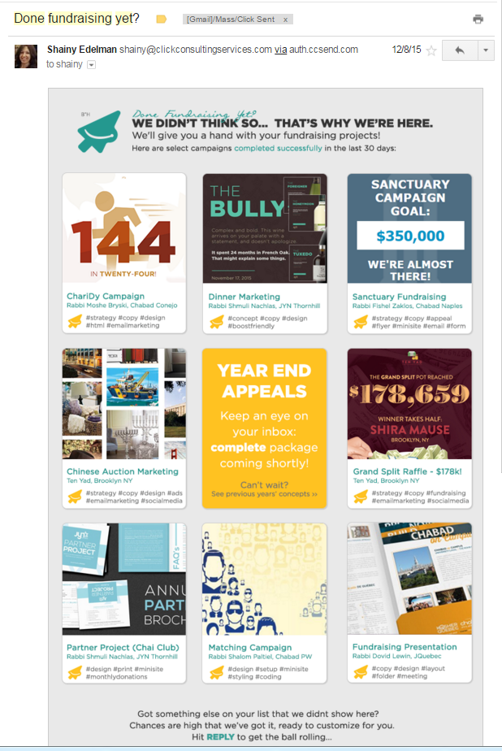
Strategy
Pointer #2: READ - Stand out in the noise - use a great subject line.

Slide 7
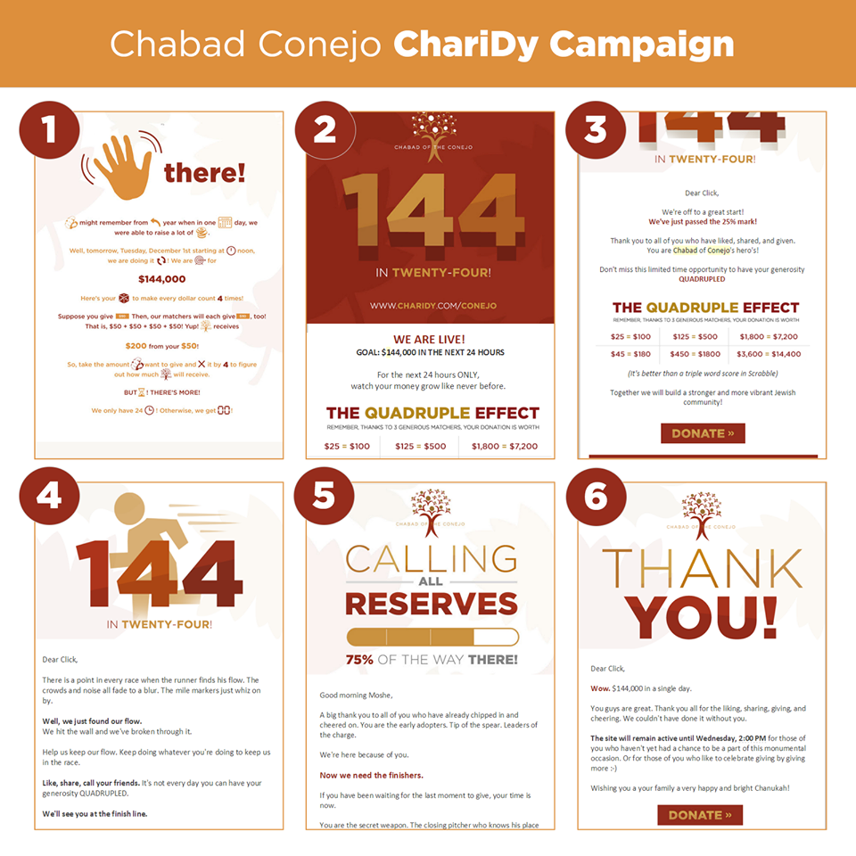

Strategy
Pointer #3: READ – Be where the people are.
Email
Facebook
Additional social channels
Whatsapp
Website
Text
Phone
News sites
Videos

Slide 8
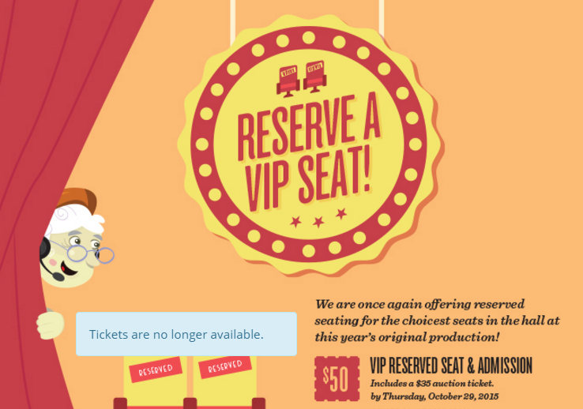
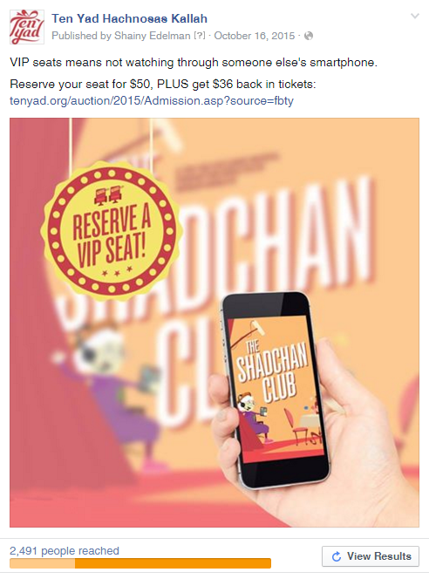
Strategy
Pointer #4: READ – Keep it tight.
We are once again offering reserved seating for the choicest seats in the hall at this year’s original production! $50 VIP reserved seat & admission, includes a $35 auction ticket.

Slide 9
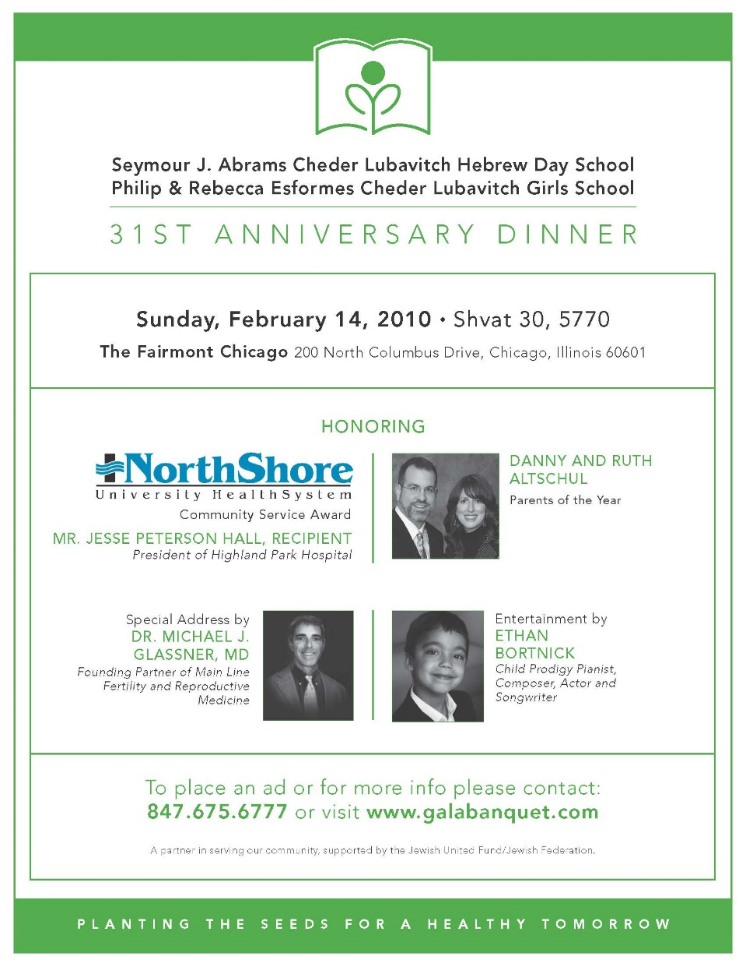
Strategy
Pointer #5: Retain - Element of Surprise

Slide 10




Strategy
Pointer #5: Retain - Element of Surprise / Reverse the Expected

Slide 11
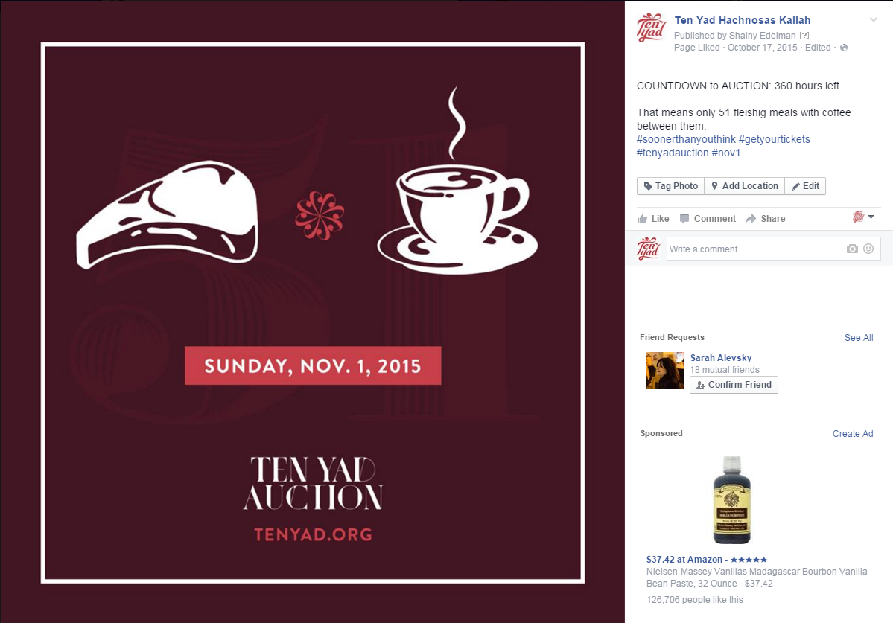
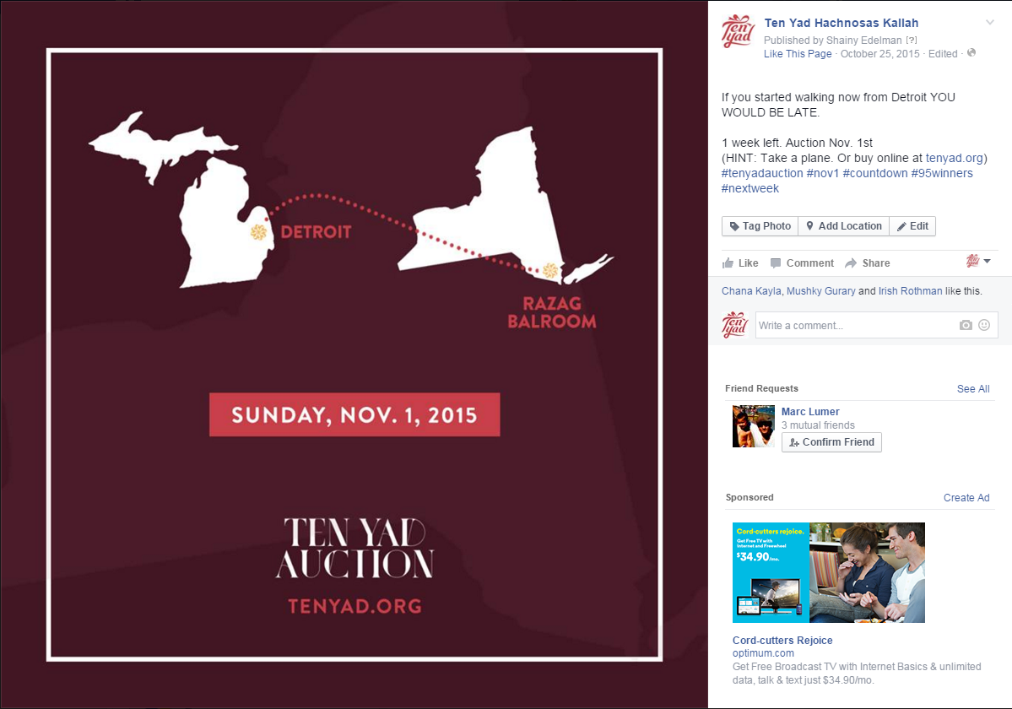
Strategy
Pointer #6: Retain- Be a purple cow (Seth Godin)
COUNTDOWN to AUCTION: 360 hours left.
That means only 51 fleishig meals with coffee between them.
‪#‎soonerthanyouthink‬ ‪#‎getyourtickets‬ ‪#‎tenyadauction‬ ‪#‎nov1‬
If you started walking now from Detroit YOU WOULD BE LATE.
1 week left. Auction Nov. 1st
(HINT: Take a plane. Or buy online at tenyad.org)
‪#‎tenyadauction‬ ‪#‎nov1‬ ‪#‎countdown‬ ‪#‎95winners‬ ‪#‎nextweek‬

Slide 12
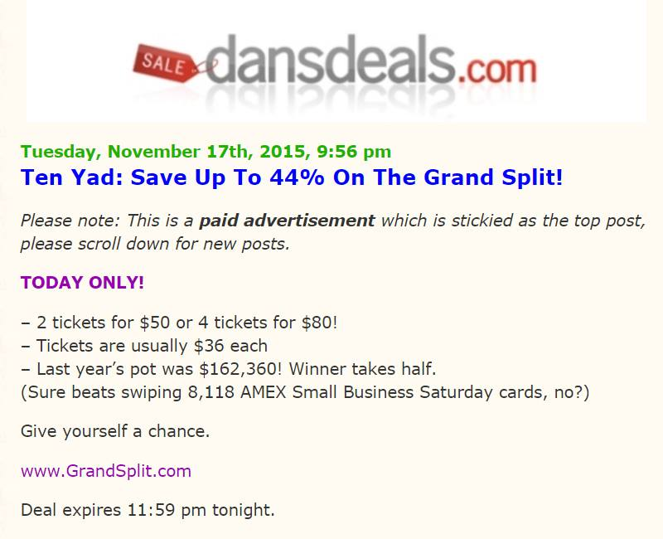
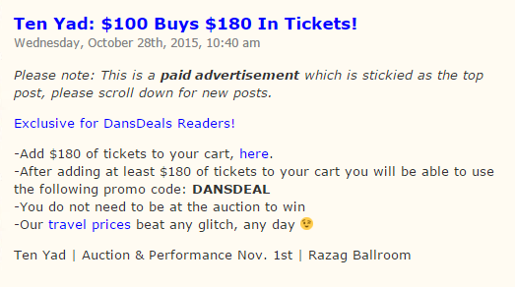
Strategy
Pointer #7: Retain- Speak the language of the people

Slide 13
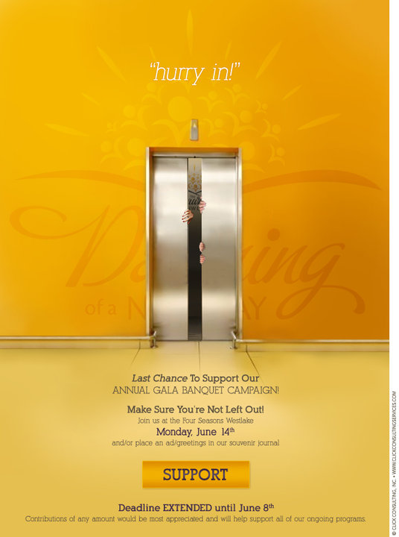
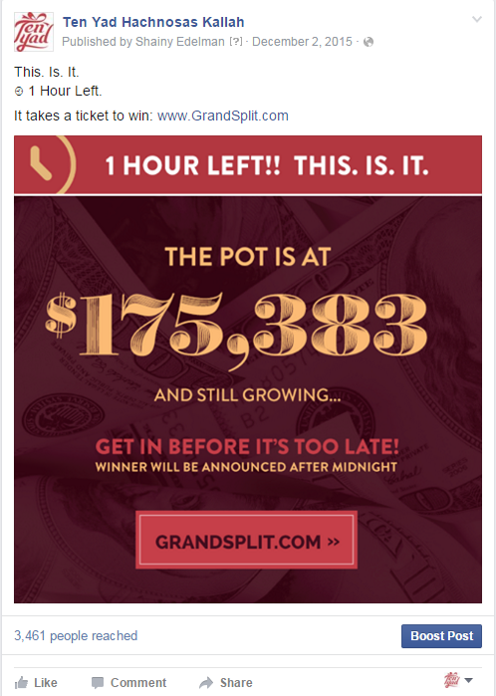
Strategy
Pointer #8: Respond - Sense of Urgency
Dinner is in 5 days.
How do you convey the sense of urgency and generate response.

Slide 14
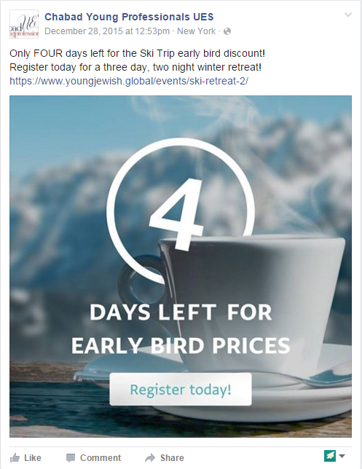
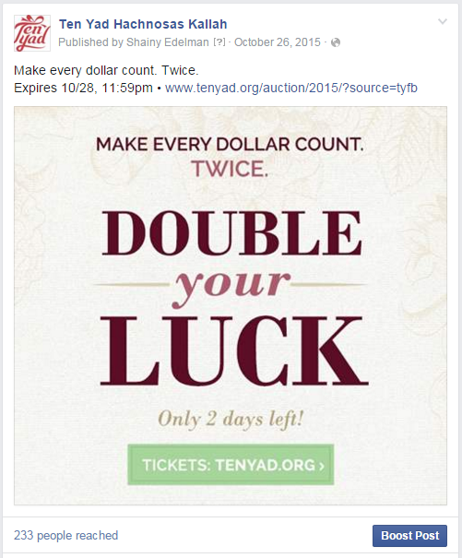
Strategy
Pointer #9: Respond – Special Deal

Slide 15
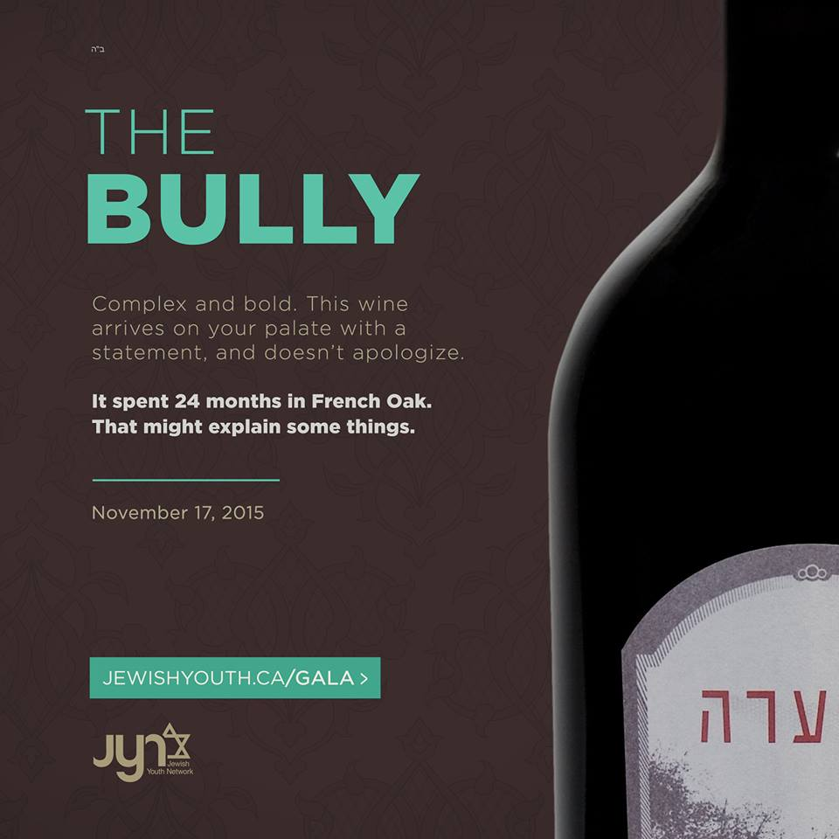


Strategy
Pointer #10: Respond - Provide Value
Dinner – what value are you offering?

Slide 16


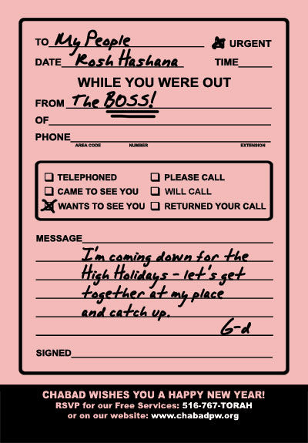
Strategy
Exercise: High Holidays Marketing

Slide 17
SYSTEMS
Pre-Execution
Every structure needs a good foundation. Do you have a platform to market from easily & effectively?

Slide 18
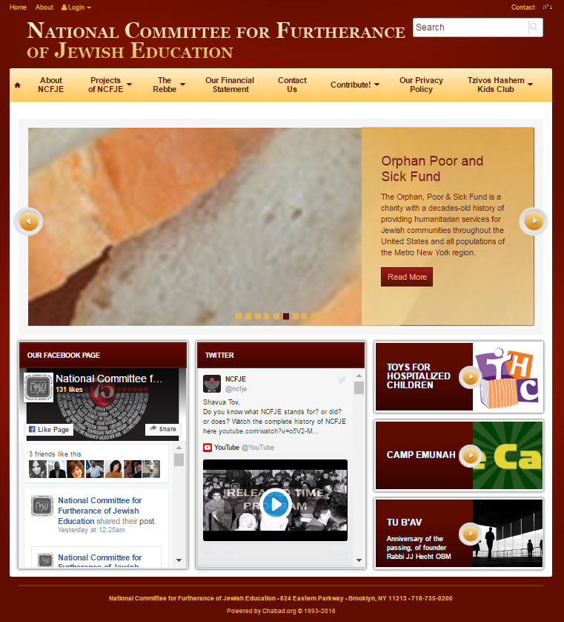
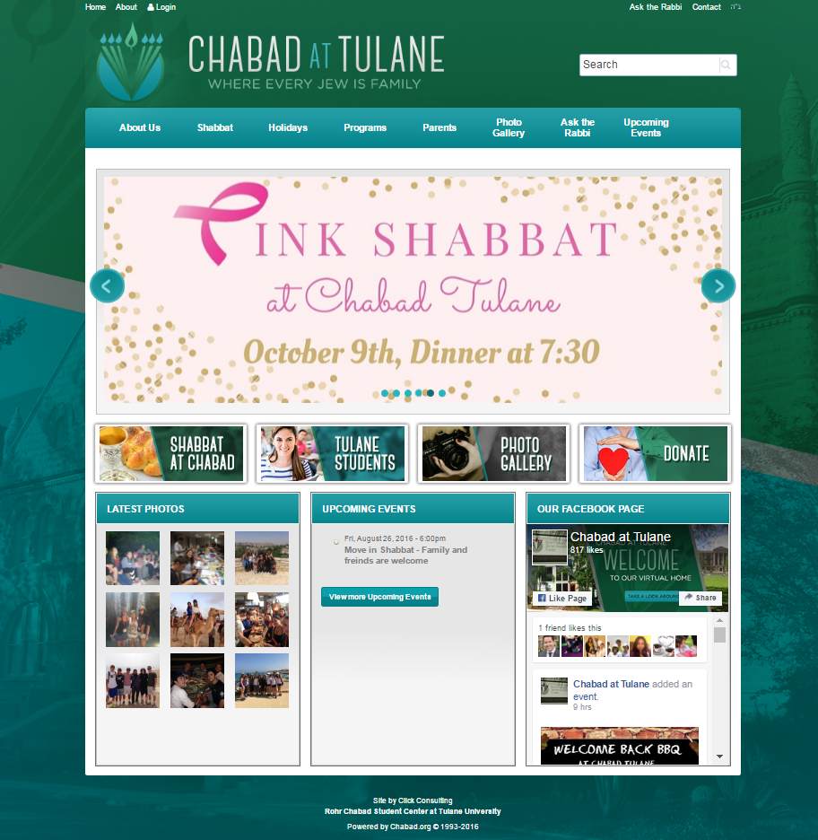
SYSTEMS
[1] Website
Checklist:
Do you have a designated place to post an event
Are you collecting email addresses
Is there a facebook link or feed?
Is my website ALWAYS current?
No unnecessary items

Slide 19
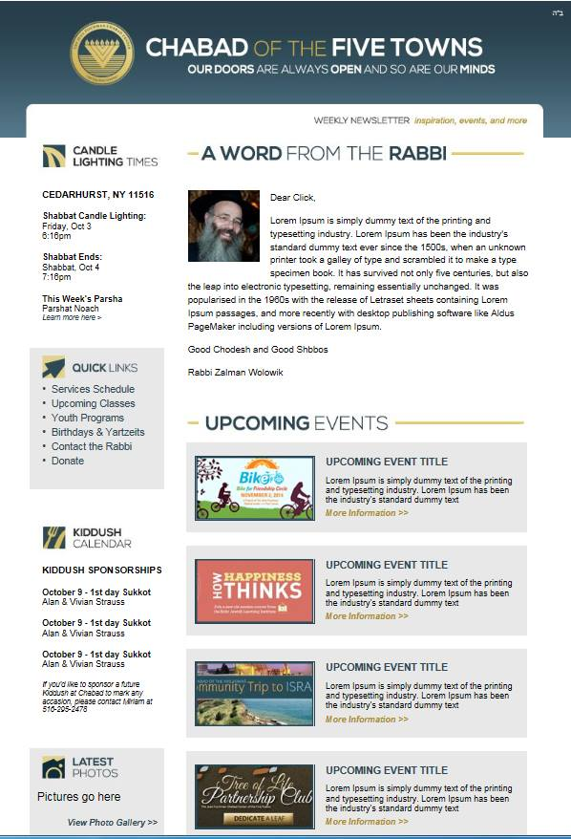
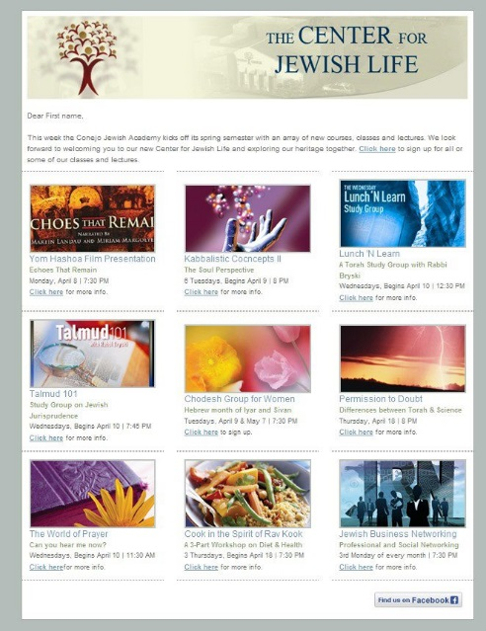
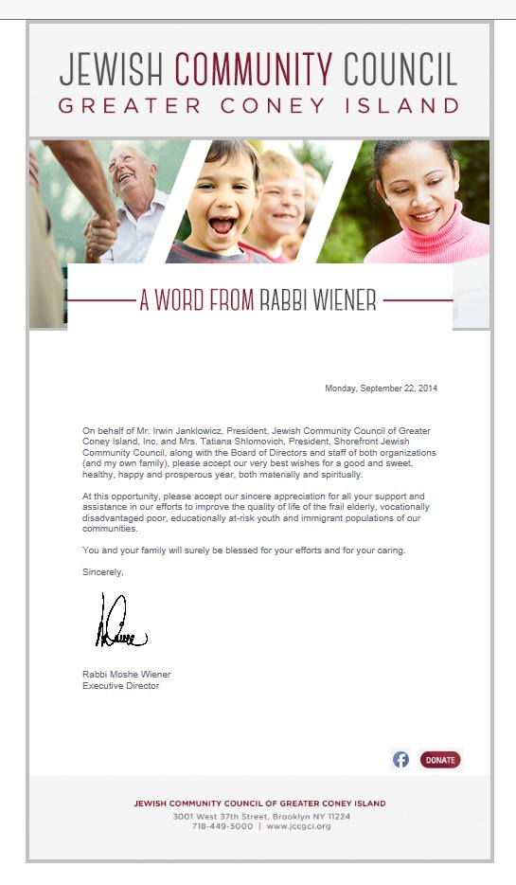
SYSTEMS
[2] Email Marketing
Build your lists on Communicator
  Website sign up field or pop up – Permission based marketing
  Get email addresses from ALL attendees
  of each event
  Targeted lists based on interests
Create 3 templates ready for use:
  1 weekly email newsletter
  1 memo template
  1 events template
Build a trust-based relationship:
  Relevant and helpful content
  Ongoing interaction
  Permission-based marketing: Where people allow you into their lives and look forward to hearing from you because you are a trusted person who provides them with relevant and useful information.

Slide 20
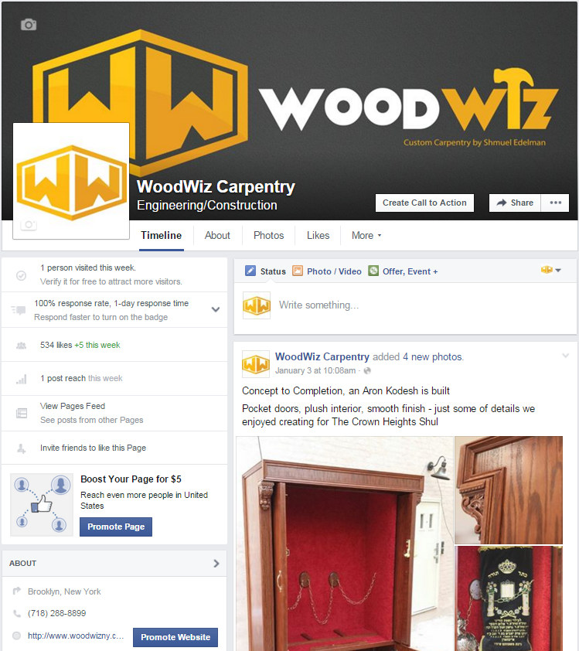
SYSTEMS
[3] Facebook Page
Facebook Page Setup:
  Create a thumbnail and banner in line with your brand
  Thumbnail should always be your logo. Usually on a white background.
  Please don’t use photos as your thumbnail, how will people recognize your posts in their newsfeed if the photo keeps changing?
  Suggestion: don’t use the cover photo area to post events, while it’s a good way to get attention, it’s not really correct use of your page. The cover should represent your organization in a general way (i.e. picture of your building / shul / beautiful group photo), and events should be posted as status updates.
  Customize all areas

Slide 21
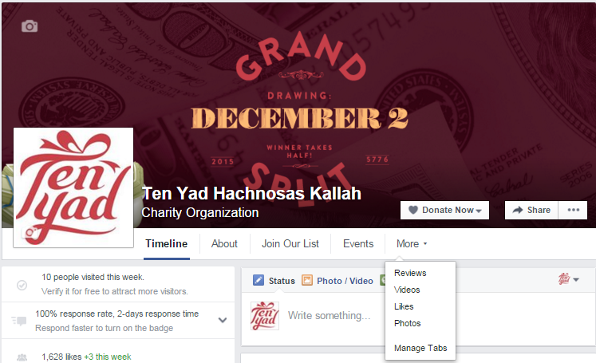
SYSTEMS
[3] Facebook Page
Customize areas
  Add a donate button to your site (your FB page must be categorized as non-profit to do so: www.facebook.com/business/help/694386777360892 )
  Join our email list
Build Likes
  Start by importing your email list: Export all your contacts from Communicator, then follow these instructions: https://www.facebook.com/help/212291088790957
  There are many more ways to build likes, do some research or consult with others.

Slide 22
PART 3
EXECUTION
- Your strategy is in place (RRR).
- Your systems are ready.
- Your design and content have been created.
Now promote your event.

Slide 23
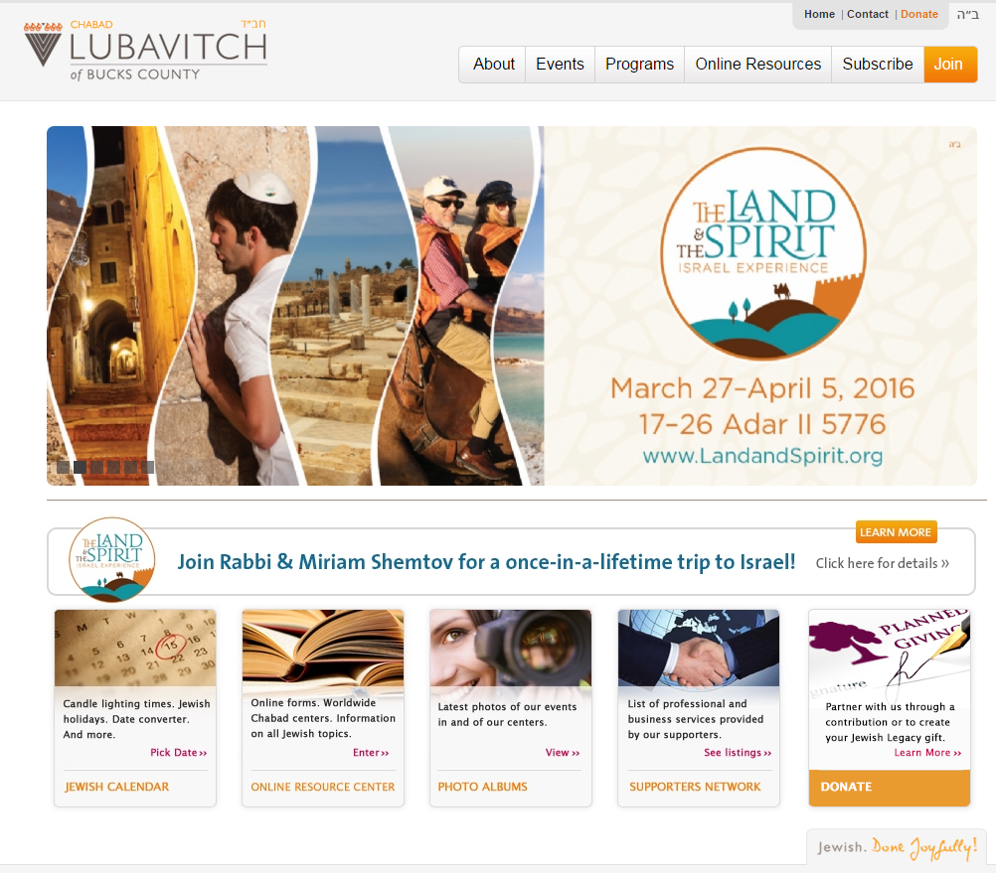

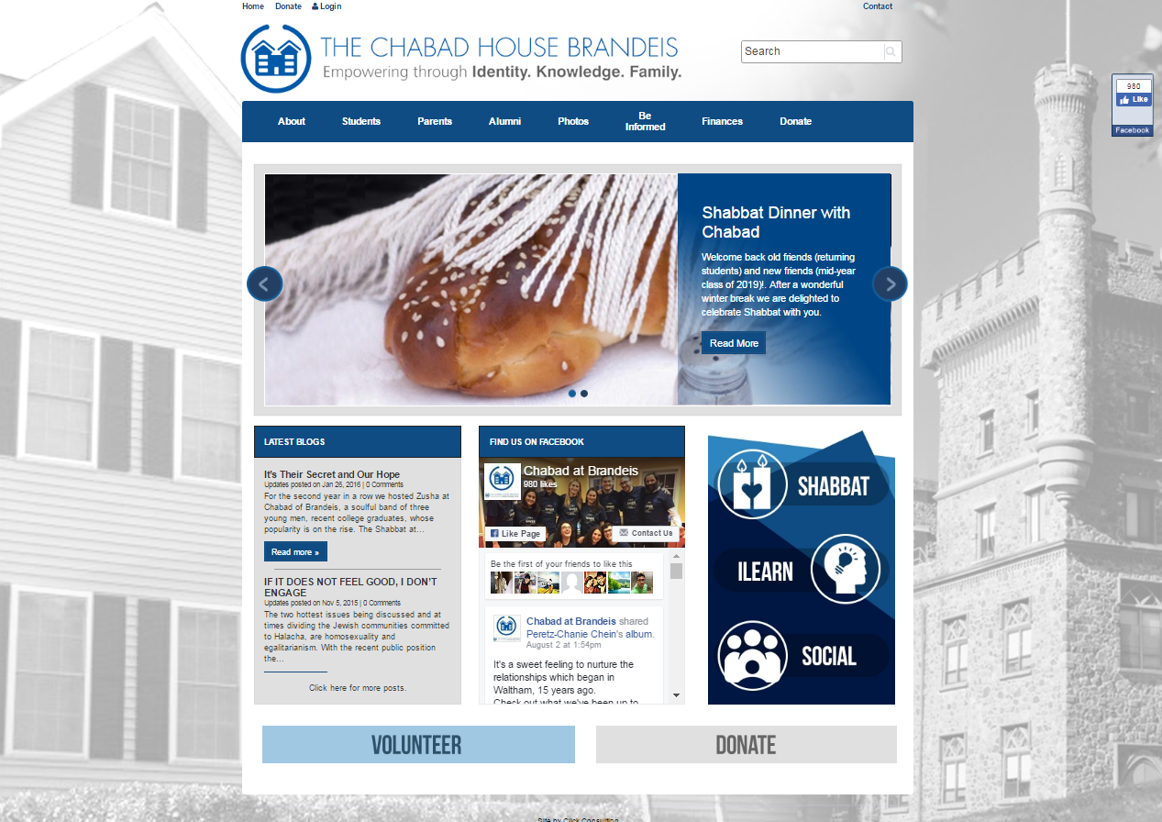
Execution
Events on your Website
Banner on homepage: with or without overlay for text

Slide 24
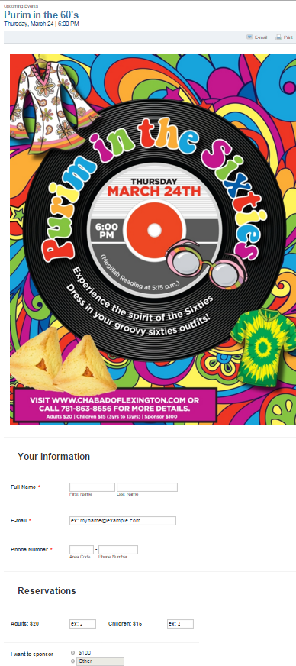
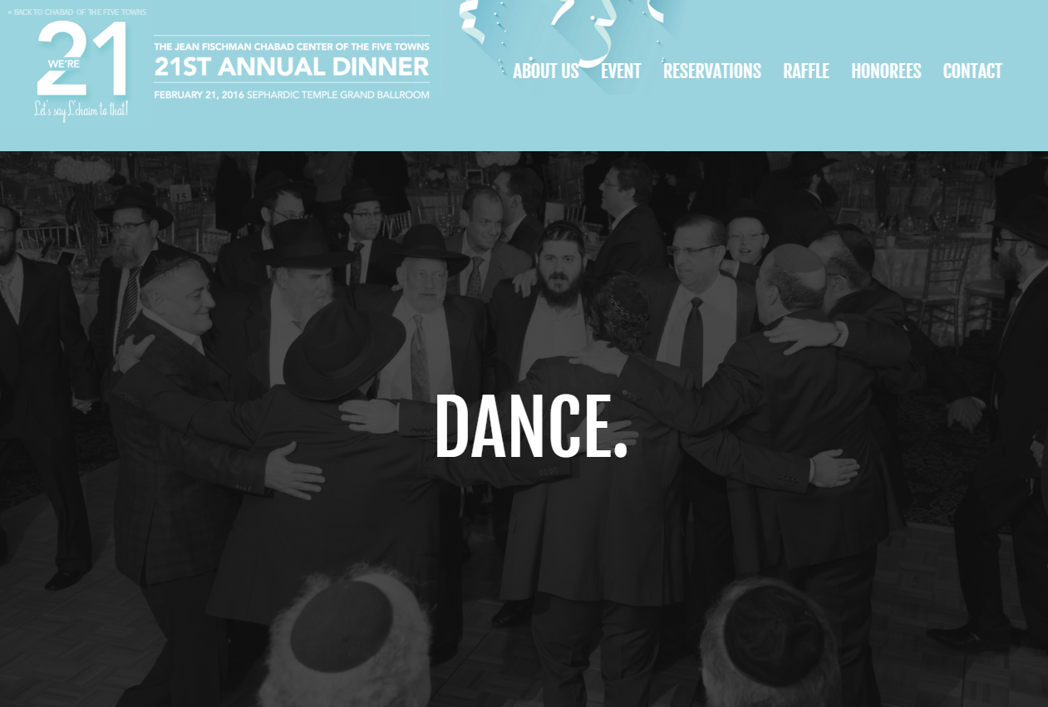
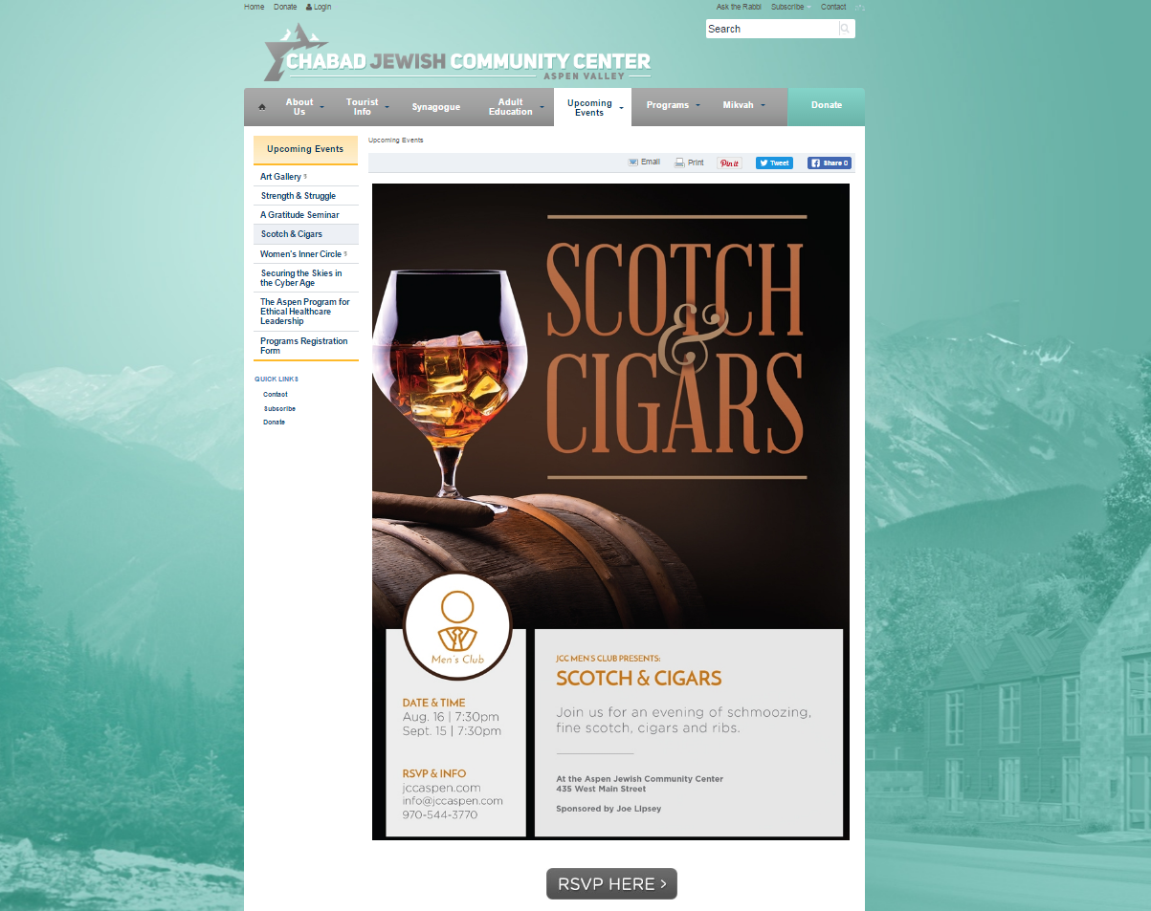
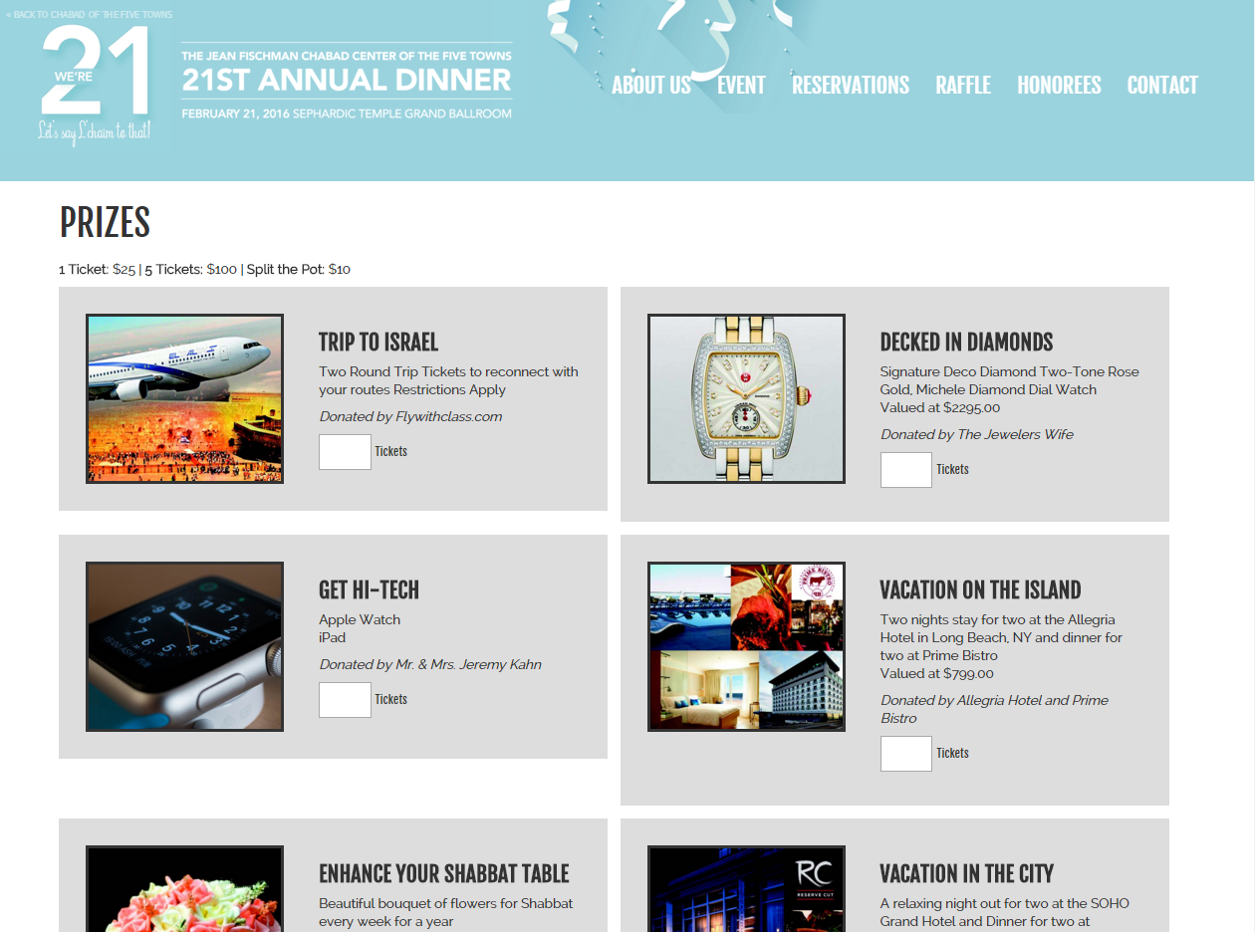
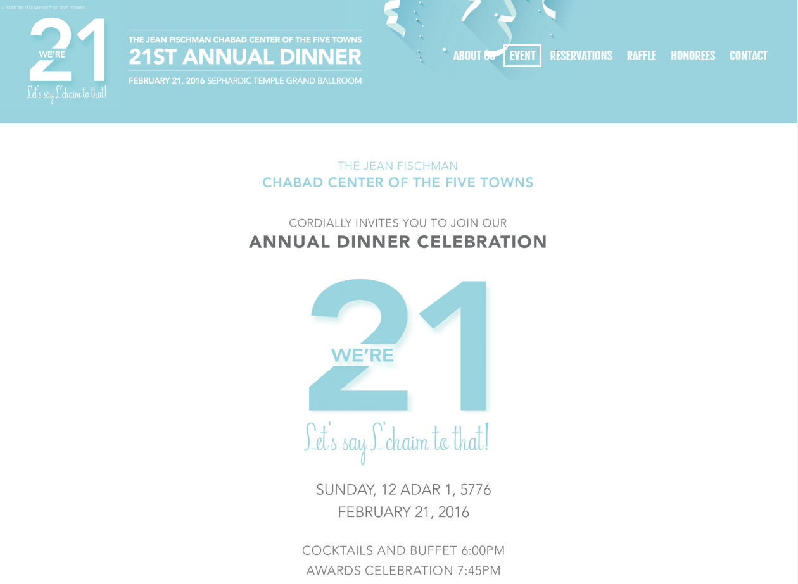
Execution
Events on your Website
Banner on homepage
Event page or minisite

Slide 25
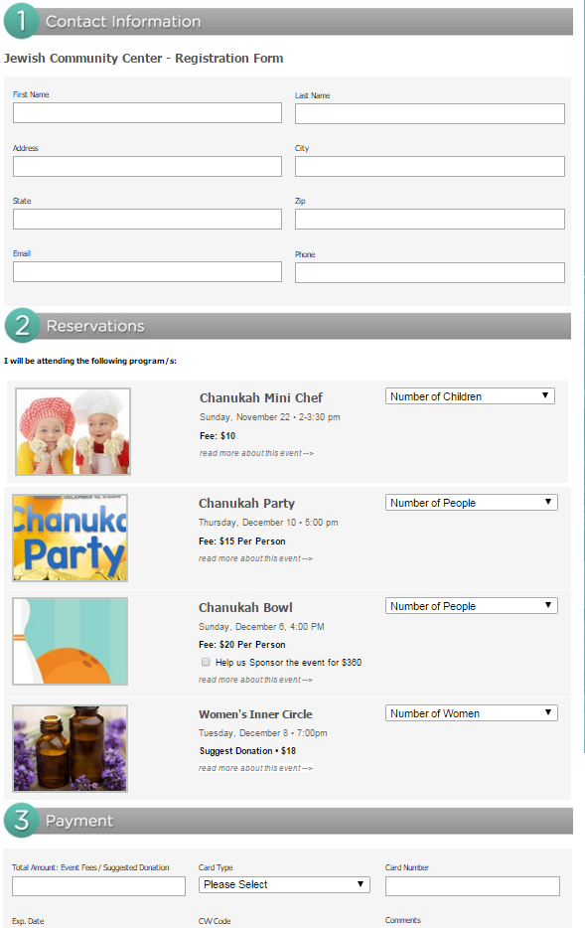
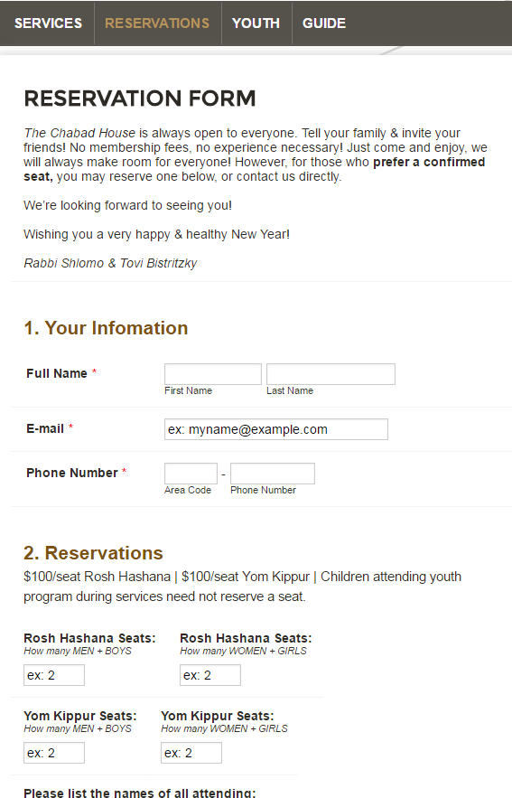
Execution
Events on your Website
Banner on homepage
Event page or minisite
Registration form – mobile friendly
  Don’t list email address for registration
  Don’t reuse all forms that are not mobile-friendly, create a new one in just a few minutes using form builder.

Slide 26
Execution
EMAIL MARKETING
Understand
Open Rate +
Click Rate:
Let’s set
realistic
expectations…

Slide 27
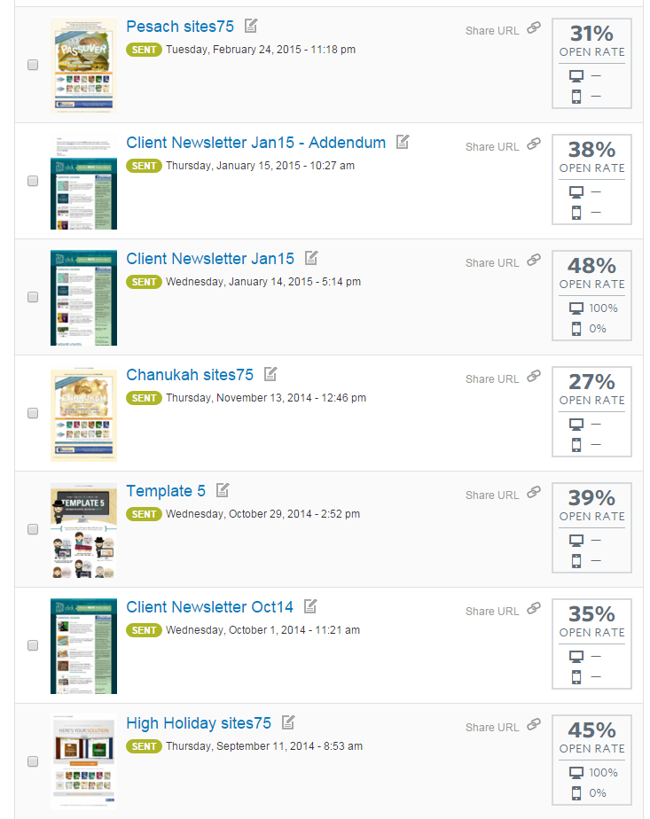
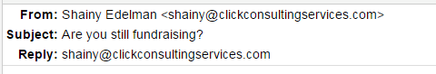

Execution
EMAIL MARKETING
Understand Open Rate + Click Rate
Subject line is king

Slide 28
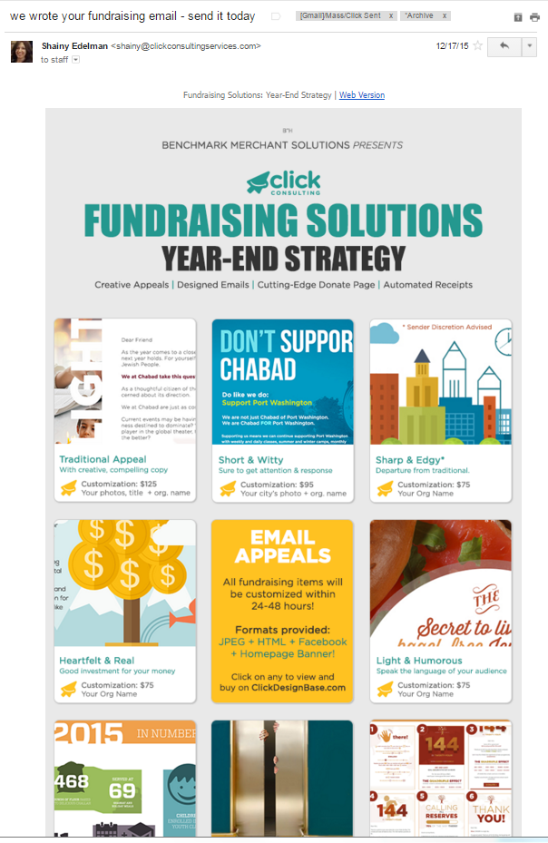
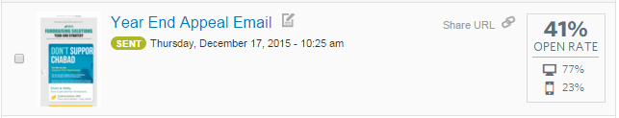
Execution
EMAIL MARKETING
Understand Open Rate + Click Rate
Subject line is king
  Ambiguous vs. Direct

Slide 29
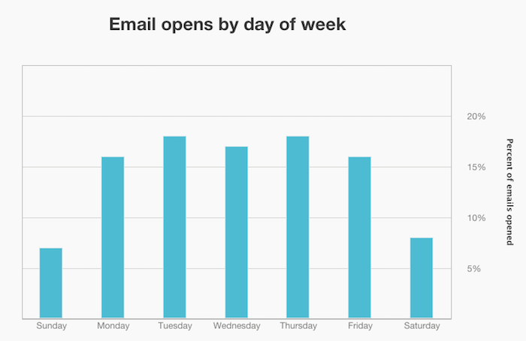
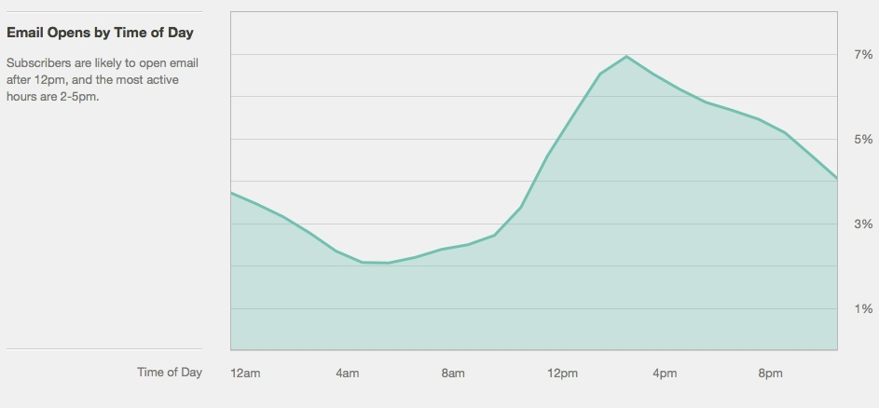
Execution
EMAIL MARKETING
Understand Open Rate + Click Rate
Subject line is king
Best send day + time: avoid Mondays & Fridays, mornings and end of day.

Slide 30
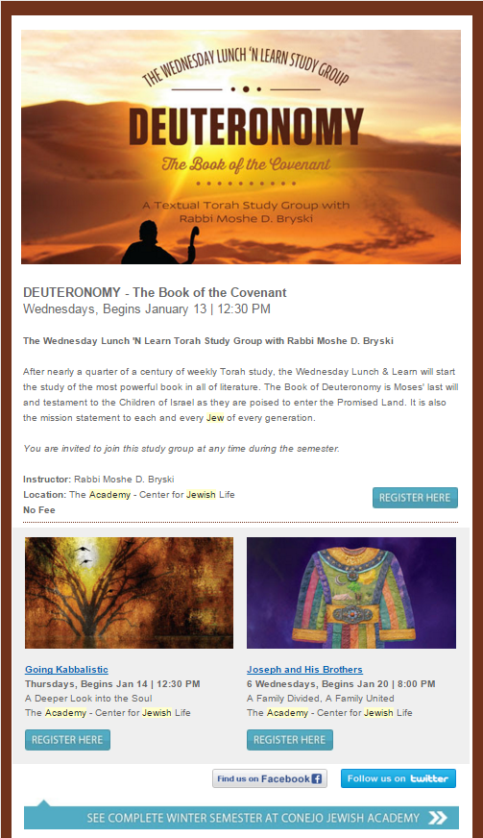
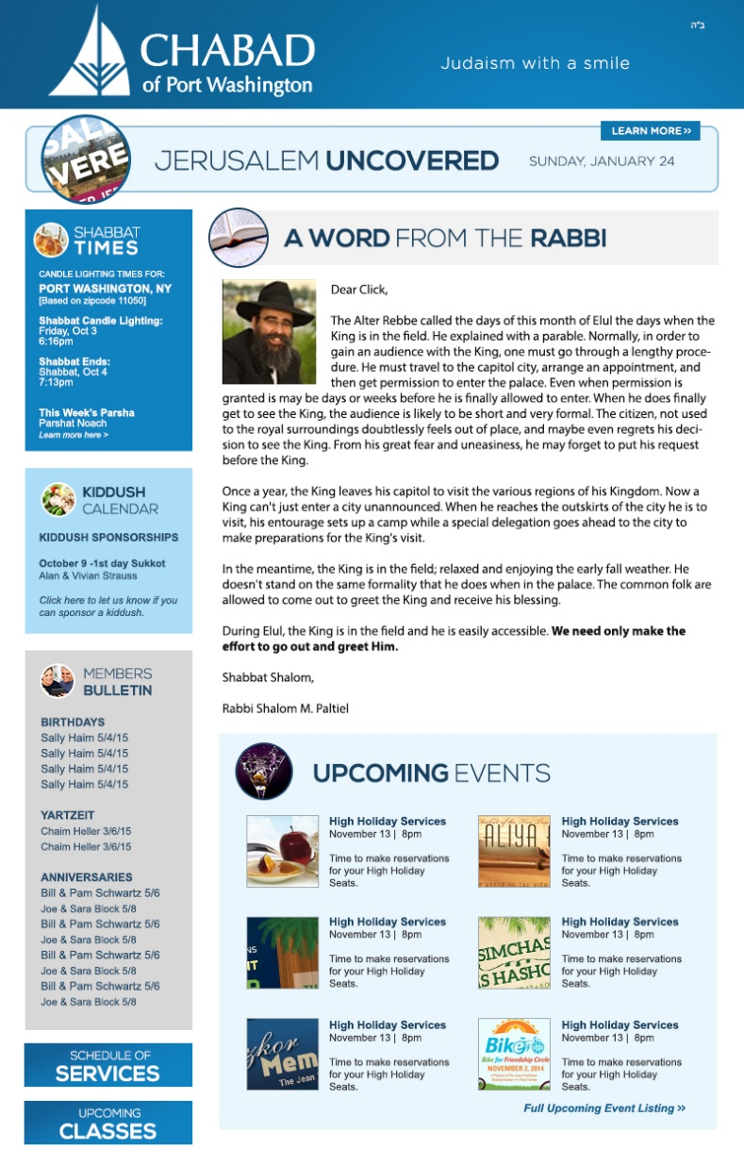
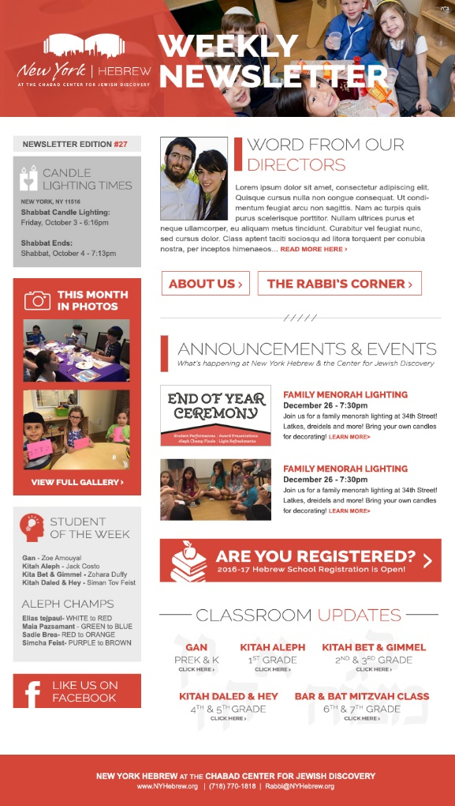
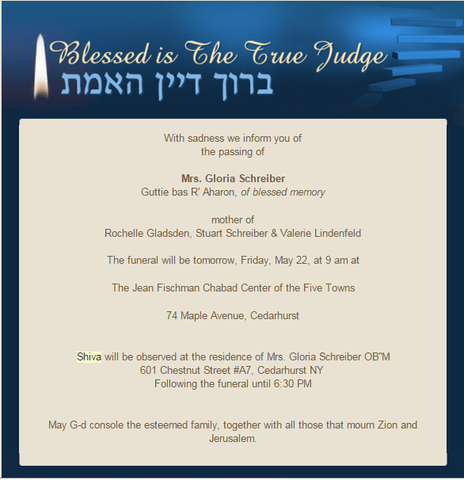
Execution
EMAIL MARKETING
Understand Open Rate + Click Rate
Subject line is king
Best send day / time
How many per week?
Less is more

Slide 31
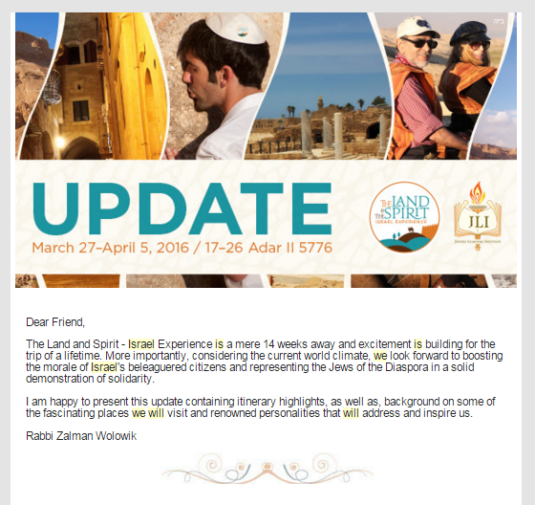
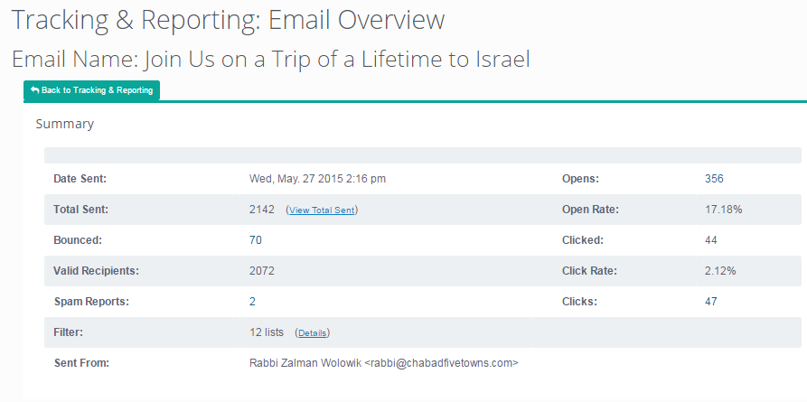
Execution
EMAIL MARKETING
Understand Open Rate + Click Rate
Subject line is king
Best send day / time
How many per week?
Constant Contact / Communicator
Targeted lists: Reports based on opens / clicks

Slide 32
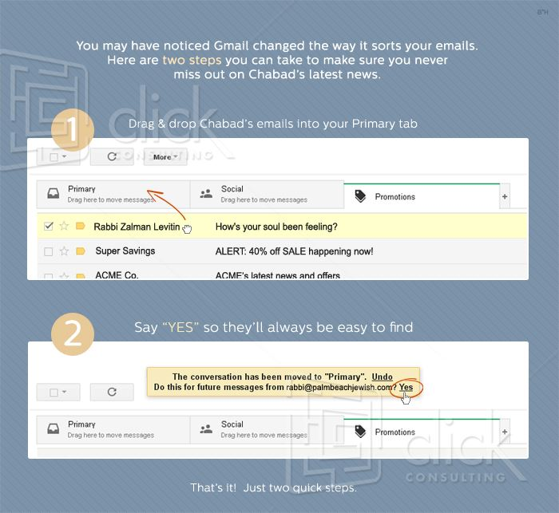
Execution
EMAIL MARKETING
Understand Open Rate + Click Rate
Subject line is king
Best send day / time
How many per week?
Constant Contact / Communicator
Targeted lists: Reports based on opens / clicks
Promotions folder

Slide 33
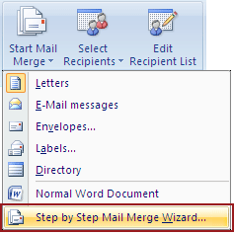
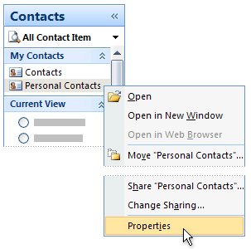

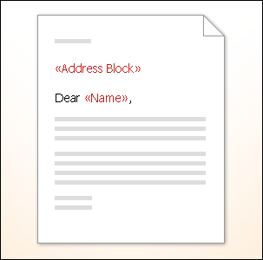

Execution
EMAIL MARKETING
Understand Open Rate + Click Rate
Subject line is king
Best send day / time
How many per week?
Constant Contact / Communicator
Targeted lists: Reports based on opens / clicks
Promotions folder
Outlook

Slide 34


Execution
EMAIL MARKETING
Understand Open Rate + Click Rate
Subject line is king
Best send day / time
How many per week?
Constant Contact / Communicator
Targeted lists: Reports based on opens / clicks
Promotions folder
Outlook
Series of emails

Slide 35


Execution
EMAIL MARKETING
Understand Open Rate + Click Rate
Subject line is king
Best send day / time
How many per week?
Constant Contact / Communicator
Targeted lists: Reports based on opens / clicks
Promotions folder
Outlook
Series of emails

Slide 36


Execution
SOCIAL MEDIA: FACEBOOK
Create a Branded Campaign:
Stay mindful of recognition factor
Create Event
www.facebook.com/help/210413455658361
  Banner coordinating with flyer: 784 x 295 pixels
  Link to RSVP on your site
  Designate hosts
  Invite friends (page cannot invite followers, a person who’s a host has to invite friends)

Slide 37


Execution
SOCIAL MEDIA: FACEBOOK
Post your flyer
Width = or > height (aim for square or wide rectangle, not tall rectangle). Request this version of your flyer from your designer.
PNG not JPEG for better clarity of text
Include in copy area:
  title, subtitle or descript
  date, time,
  call to action – what do you want them to do? Make it clear – ask them to register.
  Registration link
  Hashtag/s

Slide 38




Execution
SOCIAL MEDIA: FACEBOOK
Use Hashtags

Slide 39

Execution
SOCIAL MEDIA: FACEBOOK
Post a link
Size of image should be 1200 x 628 pixels. PNG. Less than 20% text if you plan to boost it (paid advertising).
Use a virtual path i.e. JewishCenter.info/register (to create a virtual path log into Chabadone, go to settings > virtual path > new.)
At the very least, shorten the link, NOT with bitly please. Keep links branded!
  https://jewishwaynecom.clhosting.org/templates/articlecco_cdo/aid/3165501/jewish/RSVP-for-Whiskey-Tasting/lang/en
  SAME AS: JewishWayne.com/3165501

Slide 40

Execution
SOCIAL MEDIA: FACEBOOK
Post a link: Step by Step
Copy the link of your website page. Don’t shorten the link in this case.
Start by pasting your link in the status area
Hit the + sign to upload your 1200 x 628 png image in place of the default suggested images shown. (If the default images work, hey, feel free to use them!)
Now Remove the link from status area and replace with custom message (i.e. Reserve your seat today…)
Edit the link name and description that appear beneath the message. Simply click on it and you’ll be able to replace what appears by default.
Post!

Slide 41


Execution
SOCIAL MEDIA: FACEBOOK
Paid Posts: Boosting a post / Ads
Boost image, link or event in order to reach more people. Otherwise your post will typically reach about 7% of those who like your page ☹
Caution! Some speculate that boosting will further limit your posts when you don’t boost as facebook will see that you’re ready to spend… do your own research.
I often like to target friends of people who like my page, in my location. OR target people in your city + X miles. If you target people in your city you must narrow down interests so you hopefully reach majority jewish people, i.e. interests might be Jewish, Shabbat, Yom Kippur, Israel…

Slide 42

Execution
SOCIAL MEDIA: FACEBOOK
Grid tool Guidelines:
facebook.com/ads/tools/text_overlay
In a nutshell: careful to only have 20% text or less. While facebook is no longer rigid about this, they’ll usually let your ad go regardless but they’ll warn you that it will reach much less people. Not worth it, just cut down text and use the status area to include the text that has to be shared…

Slide 43


Execution
SOCIAL MEDIA: FACEBOOK
Beyond your page
Share on your personal profile
  Log in as YOU (not as your page, make sure it shows your name top right not your page name)
  In search bar type your page name and click on it.
  Now hit the share button on the post that that you’d like to share on your page.
  Click “share on your own timeline”
  Feel free to use default message from the page’s post or type your own.
Use any of the other sharing options…

Slide 44

Execution
SOCIAL MEDIA: FACEBOOK
Beyond your page
Community Groups
  Take the time to research local community groups in your area – it might be a jewish craigslist, a jewish mom’s group – post relevant events there so long as it fits the admin’s criteria of what may be posted.
  Follow share instructions on previous slide.

Slide 45

Got Questions?
Reach out via email:
Chabad One Event Reservation System
Constant Contact
Shainy Edelman
CEO/Creative Director
Click Consulting
shainy@ClickConsultingServices.com
www.ClickConsultingServices.com
www.Facebook.com/ClickConsulting

